Slide 1

Notes:
,I start with the name NAME OF ALLAH who is most kind and the most beneficent

Slide 2


PAF HOSPITAL MUSHAF, SARGODHA
CLINICO PATHOLOGICAL CONFERENCE
0830 HRS – 0930 HRS
TOPIC: THE ROLE OF IMAGING IN DIAGNOSIS AND MANAGEMENT OF ACUTE APPENDICITIS
PRESENTER: DR. ANAM ZAHRA
DATE: 13 FEB, 2026
TIMINGS: 0815 HRS (PGTS & HOS)
0825 HRS (HODS, SUPERVISORS)
VENUE: CONFERENCE ROOM
Notes:
WORTHY sir respected hods and my dear fellow AOA

Slide 3
THE ROLE OF IMAGING IN ACCURATE DIAGNOSIS AND MANAGEMENT OF ACUTE APPENDICITIS
PRESENTER
DR ANAM ZAHRA
MBBS (K.E)
PGR DIAGNOSTIC RADIOLOGY
SUPERVISED BY
WG CDR DR RIZWAN SAQIB
MBBS ;FCPS
HOD RADIOLOGY DEPARTMENT
PAF HOSPITAL MUSHAF
Notes:
I DR ANAM RESIDENT radiology , WILL BE PRESENTING A CASE ,,,,,,,,

Slide 4
OBJECTIVE
“To highlight the importance of radiology in diagnosis of acute appendicitis enabling early intervention ,detection of complications and improved patient out come
Notes:
THE OBJECTIVEs OF MY PRESENTATION IS

Slide 5


SEQUENCE
Case Presentation
Case Discussion
Literature Review
Conclusion
Notes:
This will be the sequence of my presentation

Slide 6

CASE PRESENTATION
CASE PRESENTATION
Notes:
I WILL START WITH THE CASE PRESENTATION

Slide 7





CASE PRESENTATION
PERSONAL PROFILE
XYZ
39 years
Sargodha
PAF Hosp Mushaf
20 jan, 2026
Notes:
My PATIENT 39 YEARS OLD MALE RESIDENT OF paf base mushaf SARGODHA PRESENTED T0 surgical opd ON 20 jan 2026
With the chief

Slide 8
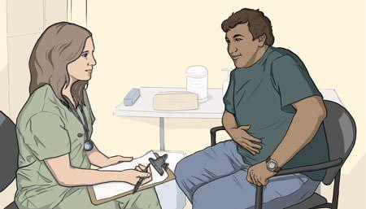
CASE PRESENTATION
CASE PRESENTATION
PRESENTING COMPLAINTS
Generalized Abdominal pain for 2 days
Notes:
WITH THE CHIEF presenting COMPLAINT OF GENERALIZED ABD PAIN FOR 2 DAYS……………my patient wasin usoh

Slide 9
CASE PRESENTATION
HISTORY OF PRESENT ILLNESS
Abdominal pain
Nausea
Notes:
MY Patient was in his usual state of health 2 days back when he developed lower abdomen pain. It was mild in intensity, dull in nature ,poorly localised. There were no aggravating or relieving factors. It was associated with nausea.There was no Hx of fever,loose stools ,constipation or vomiting.

Slide 10
CASE PRESENTATION
HISTORY OF PRESENT ILLNESS
CNS : No fits / LOC / Loss of memory
CVS : No congenital defect / palpitations
RESP : No SOB / Cough
MSK : Normal motor power
Notes:
Rest of His systemic history was unremarkable

Slide 11
CASE PRESENTATION
HISTORY
Past Medical & Surgical
History
Hernioplasty in 2008
Allergy
History
No Drug Allergy
Family
History
Unremarkable
Drug & Personal
History
No addictions / Non smoker
Social
History
Serving Officer at PAF
Notes:
Patient has a surgical history of hernioplasty back in 2008.There is no Hx of any drug allergy

Slide 12



CASE PRESENTATION
GENERAL PHYSICAL EXAMINATION
Blood Pressure
110/ 70 mmHg
Temperature
Afebrile
Pulse
78 beats/ min
RR 20 / min
SpO2 95% at R.A
Notes:
ON GENERAL PHYSICAL EXAMINATION, A YOUNG MALE, WELL ORIENTED IN TIME PLACE AND PERSON, WITH NORMAL VITALS.

Slide 13

CASE PRESENTATION
GENERAL PHYSICAL EXAMINATION
Tenderness & Rebound tenderness was positive in RIF
Alert, oriented and cooperative
No jaundice, cyanosis, clubbing
Vitals - stable
No glossitis, or tongue atrophy
Notes:
On examination his abdomen was rigid and tenderness was positive in rightiliac fossa

Slide 14
CASE PRESENTATION
SYSTEMIC EXAMINATION
GIT : Rigid, tender in RIF, bowel sounds were audible
CNS : GCS 15/15, Normal reflexes, Normal muscle tone
CVS : S1 + S2 + 0
RESP : Normal Vesicular Breathing
Notes:
. Rest of the systemic examination was unremarkable

Slide 15
CASE PRESENTATION
HISTORY OF PRESENTING ILLNESS
Consultation in Surgical OPD
Radiological Investigations
Biochemical Investigations
Notes:
After consultation in Surgical Opd ,Pt was sent to radiology department for ultrasound Abdomen mean while baseline investigations were also done

Slide 16
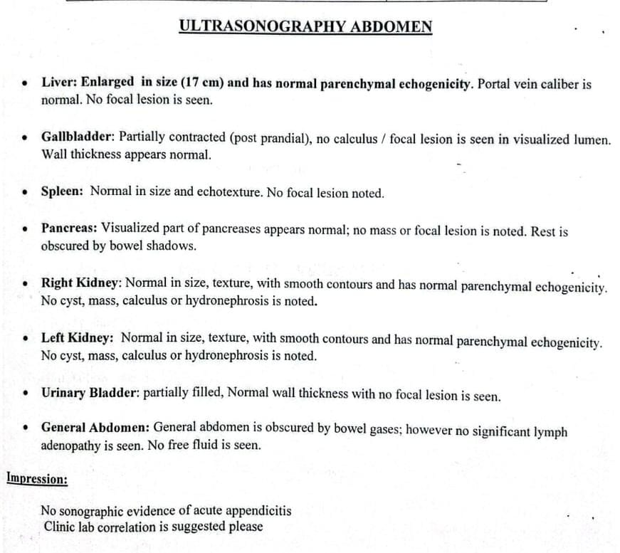
CASE PRESENTATION
ULTRASOUND ABDOMEN
Notes:
Ultrasound was unremarkable as abdomen was obscured by gut shadows… but probe tenderness was positive in RIF

Slide 17
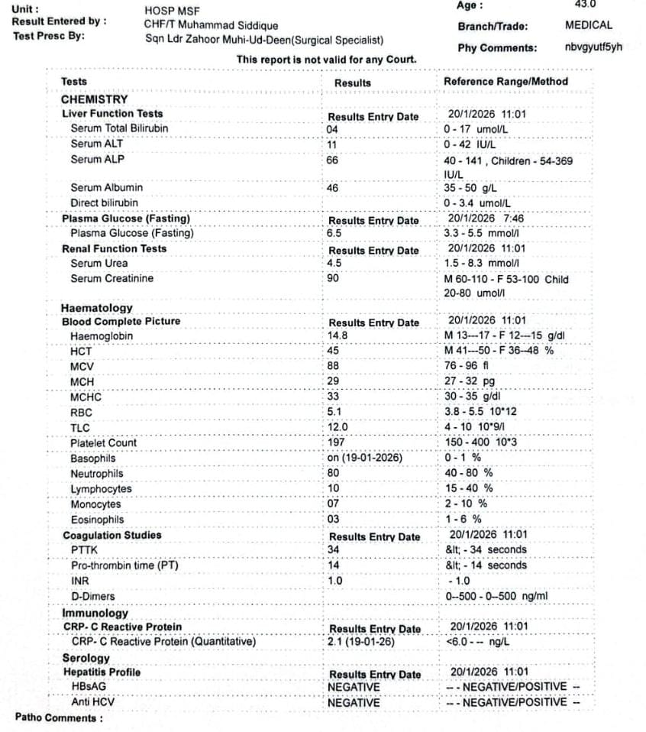
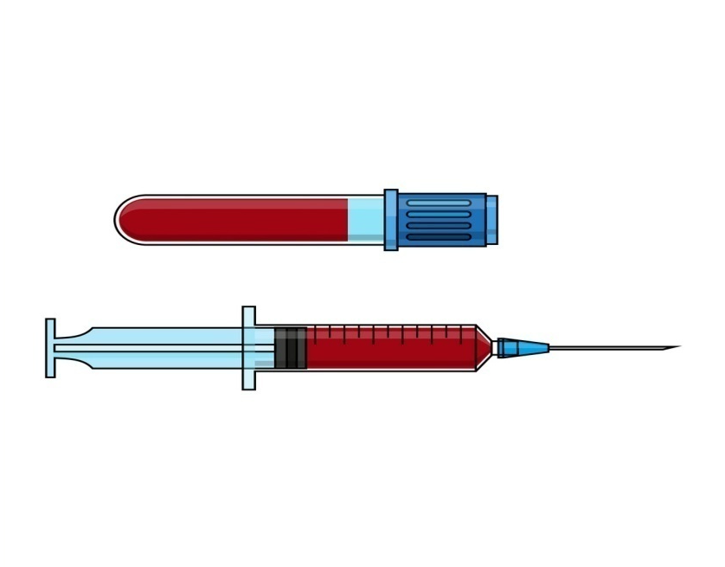
CASE PRESENTATION
BIOCHEMICAL INVESTIGATIONS
CBC: (Hb 14.8 g/dl)
TLC:12
HBsAg and Anti HCV: Negative
Notes:
Biochemical investigations were done.CBC shows mildly raised TLC .
RFTS & LFTS were within normal range.Viral serology was also negative for hepatitis B & C.

Slide 18
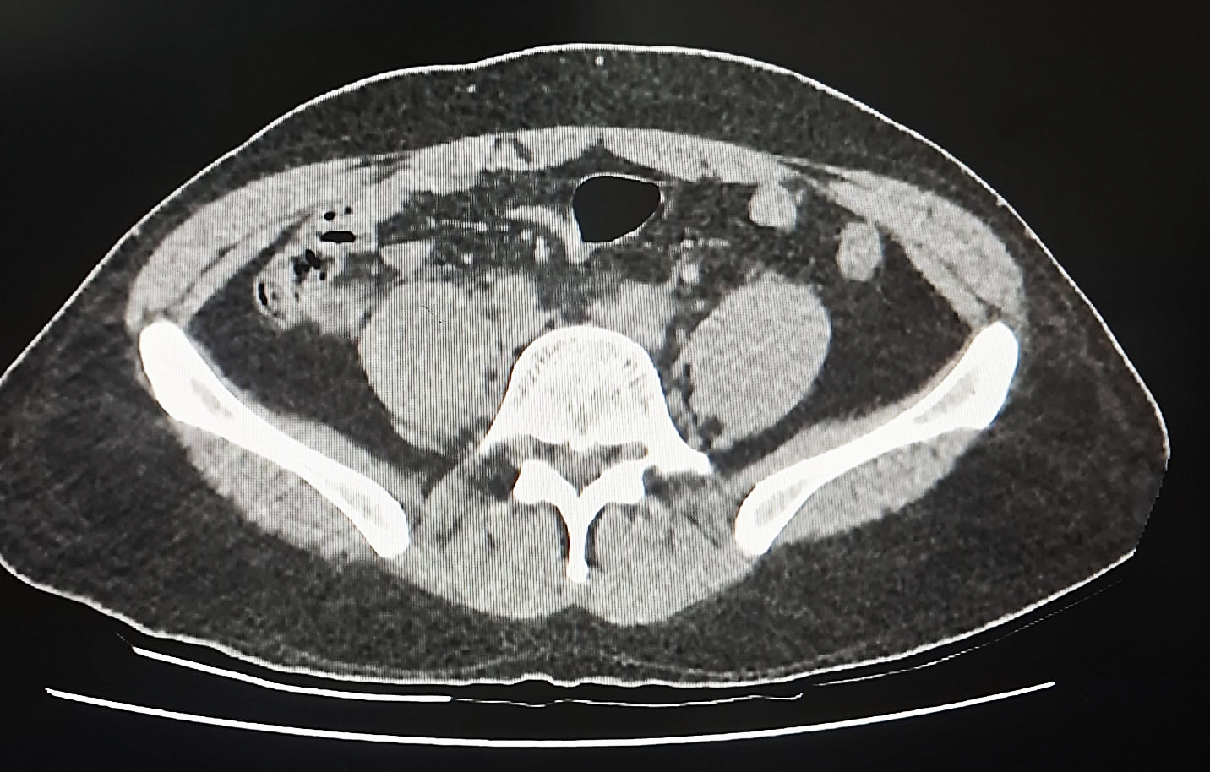
CASE PRESENTATION
CECT ABDOMEN & PELVIS
Notes:
THIS IS THE AXIAL SECTION OF THE CECT ABD PELVIS OF THE PATIENT SHOWING DILATED APPENDIX

Slide 19
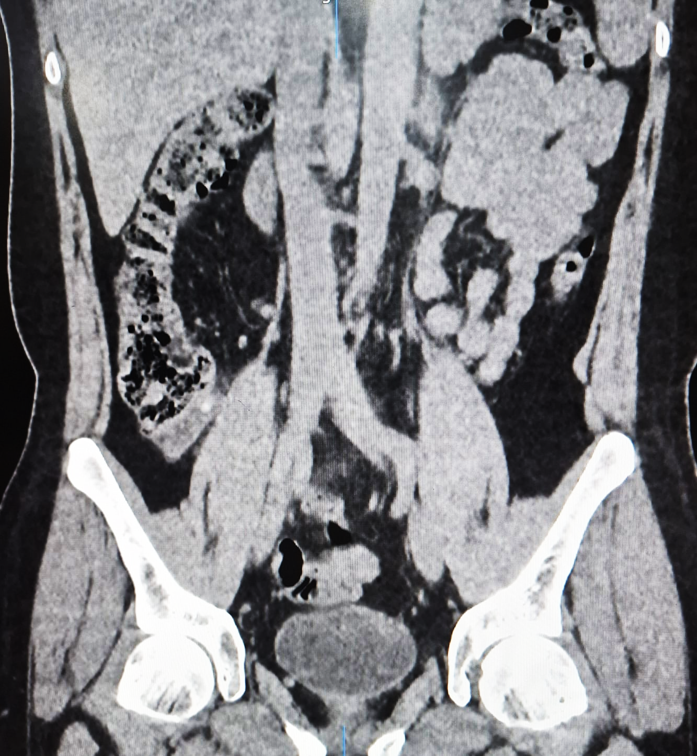
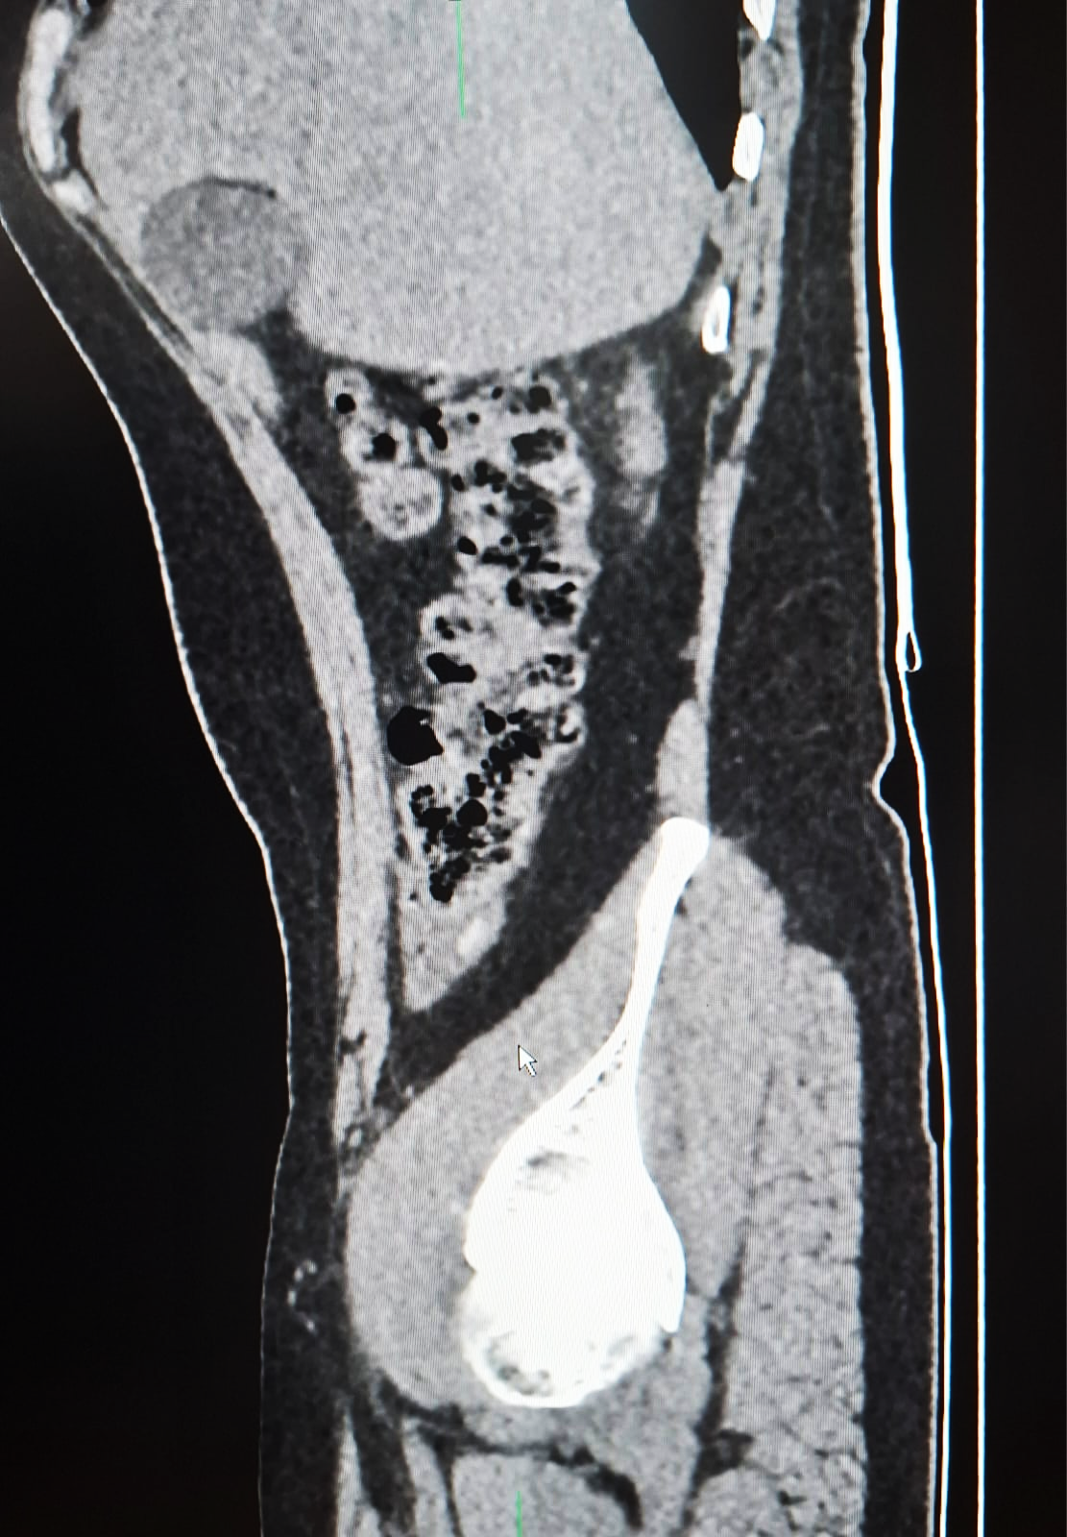
CASE PRESENTATION
CECT ABDOMEN AND PELVIS

Slide 20
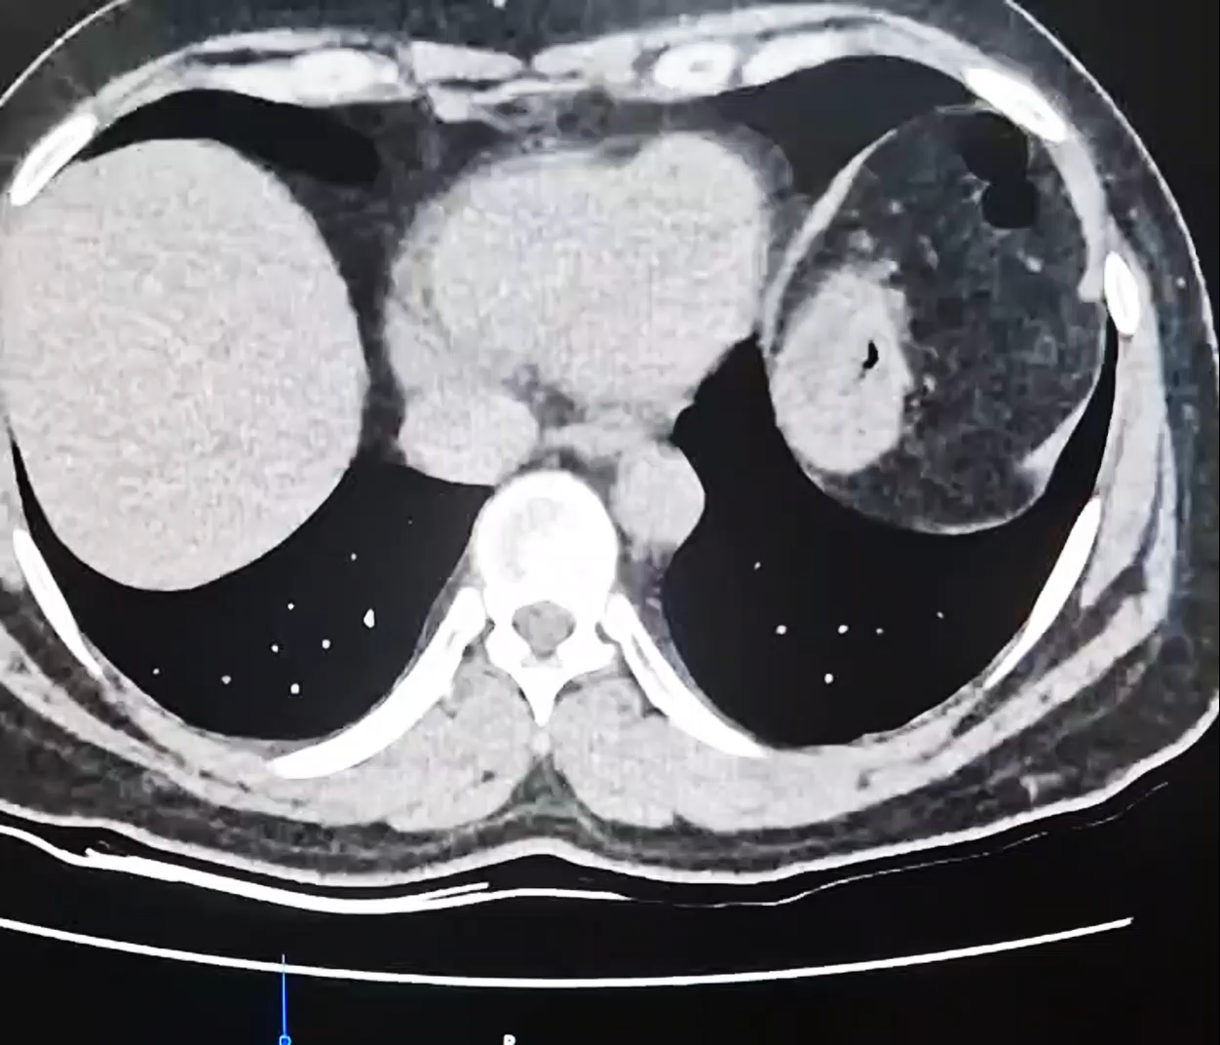
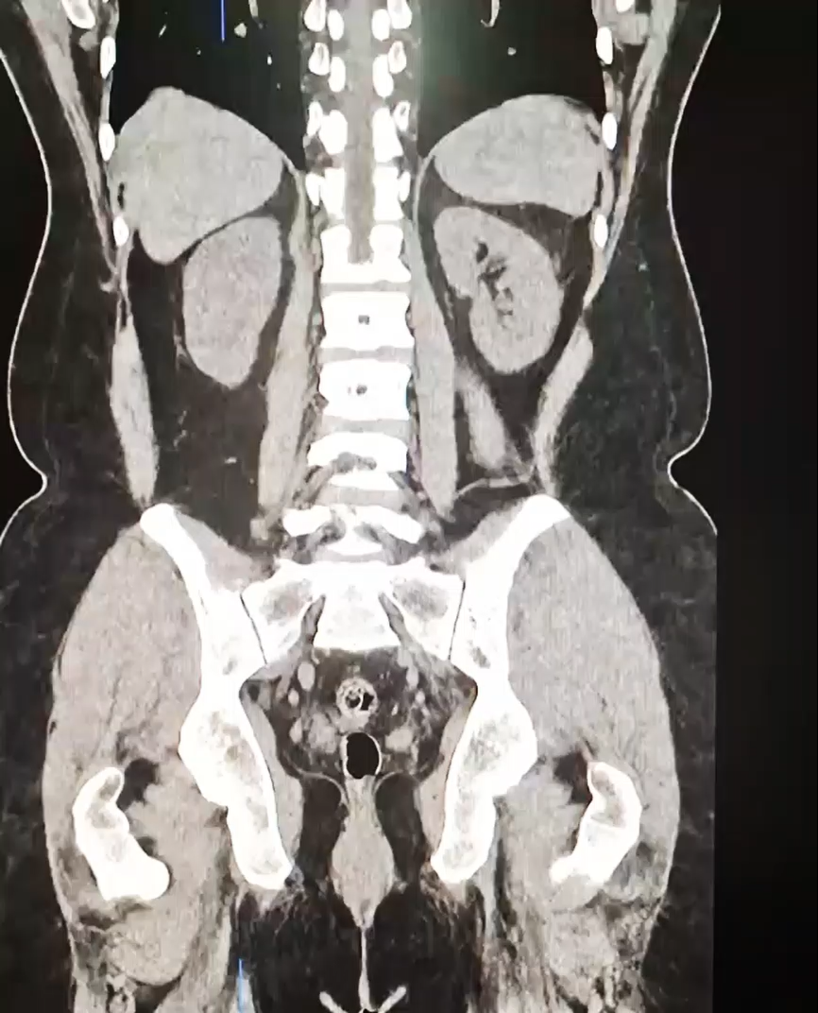
CASE PRESENTATION
CECT ABDOMEN AND PELVIS(VIDEO)
Notes:
There were no associated complications of acute appendicitis.
There was no free air under diaphragm, No CT findings of small bowel obstruction, phlegmon or pelvic abscess formation.

Slide 21
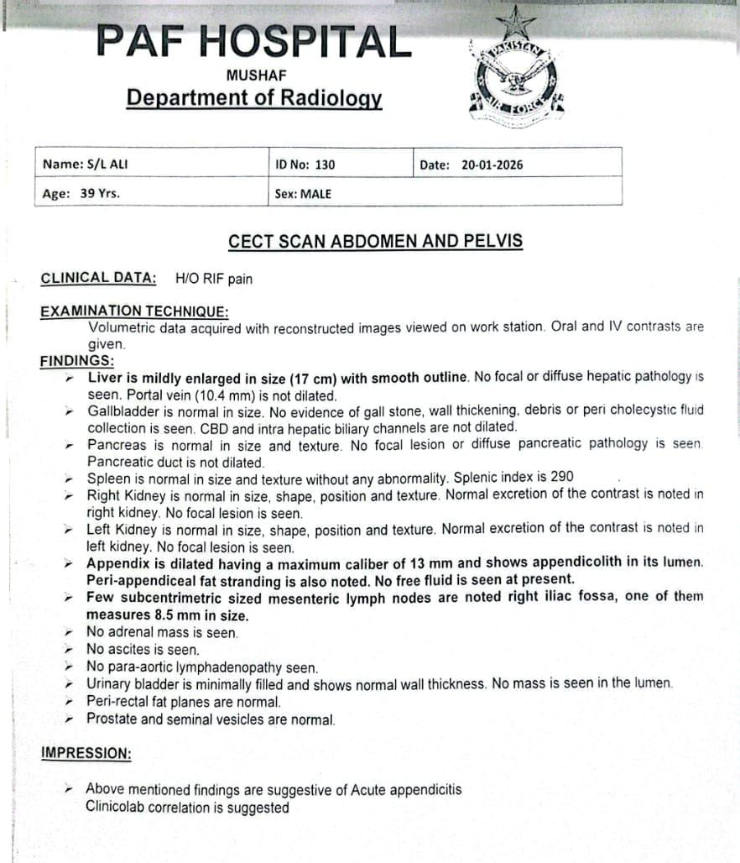
CASE PRESENTATION
CECT ABDOMEN & PELVIS
Notes:
this was the final report of CECT abdomen

Slide 22
CASE PRESENTATION
CECT ABDOMEN & PELVIS
Notes:
which showed ………………………….Surgical team was immediately informed about the cect findings

Slide 23

CASE PRESENTATION
MANAGEMENT & TREATMENT
Laproscopic Appendectomy
Notes:
Patient was kept NPO for 6 hrs and Laproscopic Appendectomy was done under GA

Slide 24
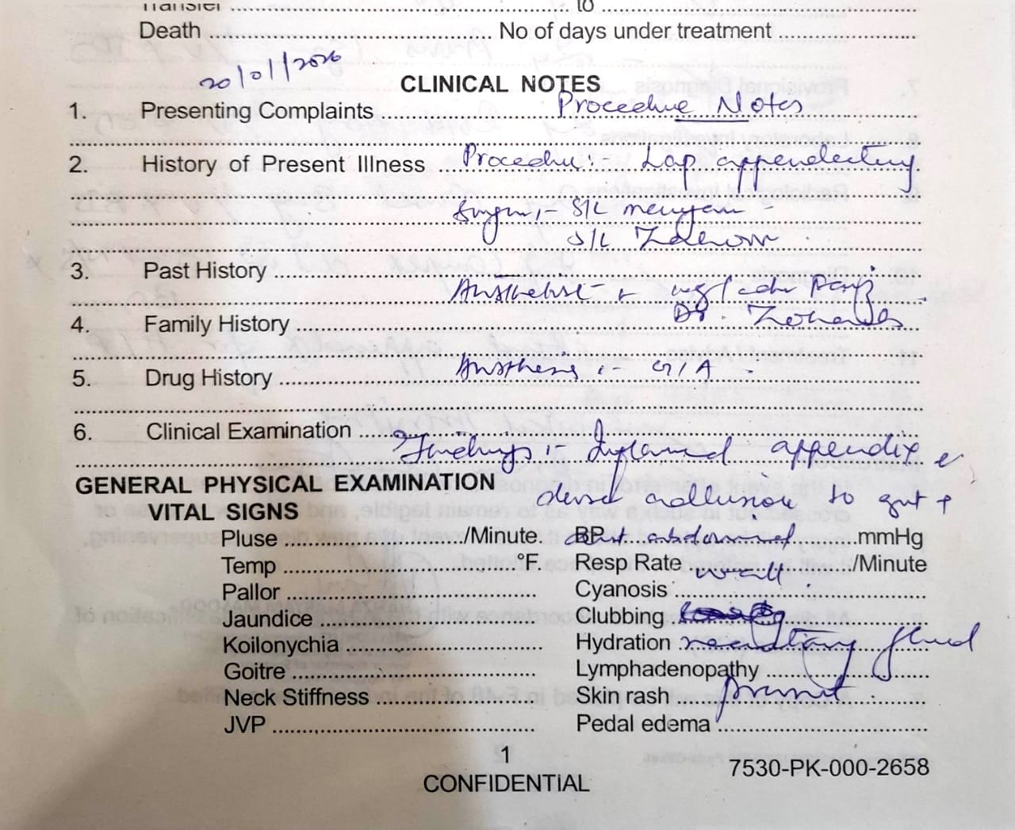
CASE PRESENTATION
MANAGEMENT & TREATMENT
Notes:
Surgical notes confirmed our radiological diagnosis

Slide 25
CASE PRESENTATION
POST OP NOTES
NPO for 6 hrs
Vital monitoring
Inj sulzone 2gm IV x BD
Inj Flagyl 500mg IV x TDS
Inj Provasc 1 gm IV xTDS
Inj Risek 40mg IV xOD
Inj compex dil in 100 ml N s x BD
Appendix specimen was sent for histopathology
Notes:
This was the post op treatment………..specimen was sent for histo pathology

Slide 26
CASE DISCUSSION
Notes:
Now coming towards the case discussion

Slide 27
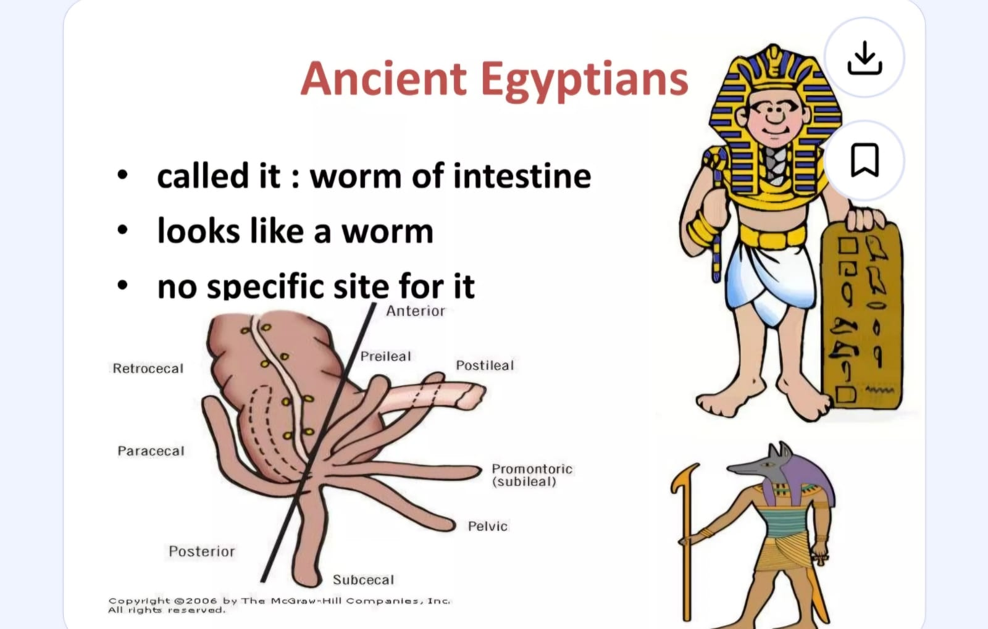
CASE DISCUSSION
ANATOMY OF APPENDIX
Appendix arises from posteromedial surface of caecum
Blind diverticulum
Mesoappendix
Appendicular artery
Notes:
Appendix arises from posteromedial surface of cecum..it is a blind diverticulum variable in length from 2 to 20 cm it has its own mesentry called meso appendix…..it is applied by appendicular artery branch of ileocolic artery

Slide 28
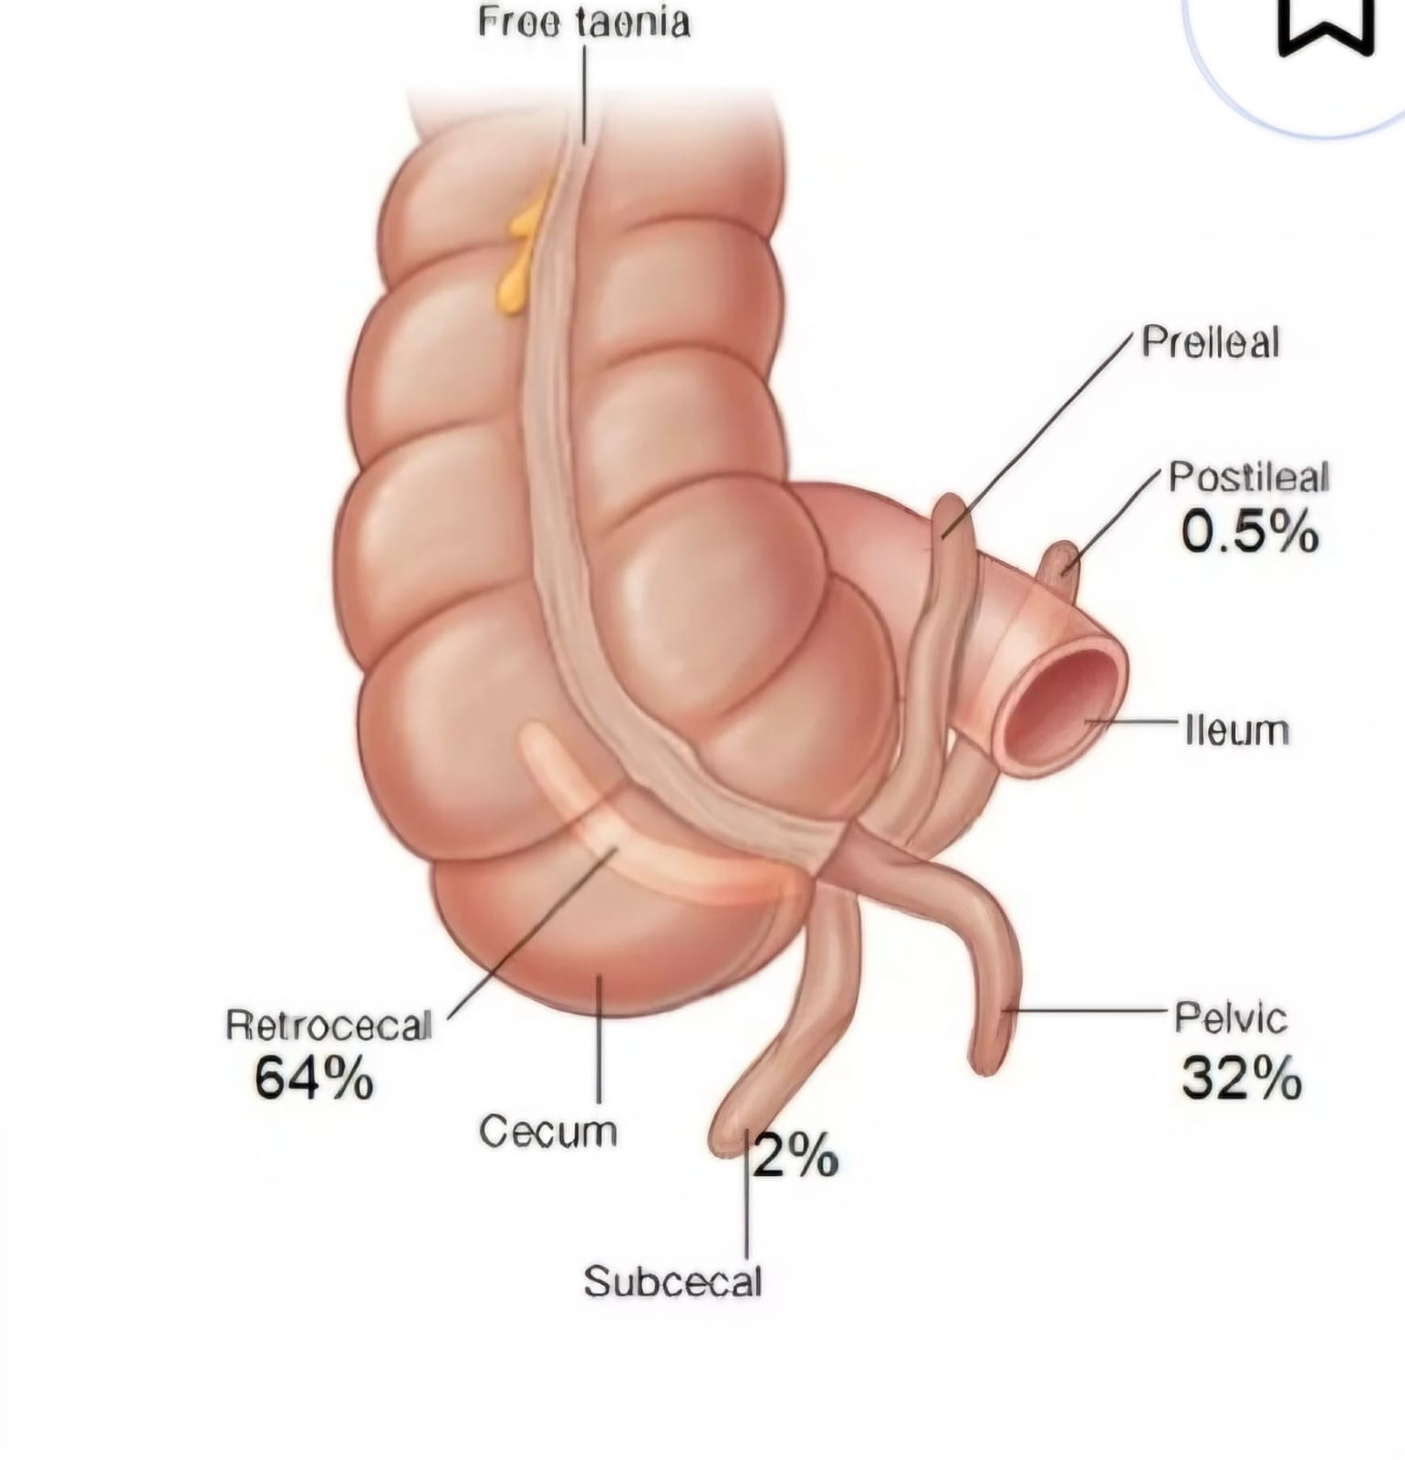
CASE DISCUSSION
ANATOMICAL VARIATION OF APPENDIX
Retrocecal ( 64%)
Pelvic (32%)
Para caecal (02%)
Pre ileal (01%)
Post ileal (0.5%)
Notes:
Based on its origin it has different variants it can be reterocecal pelvis paracecal preileal post ileal the most common is reterocecal

Slide 29
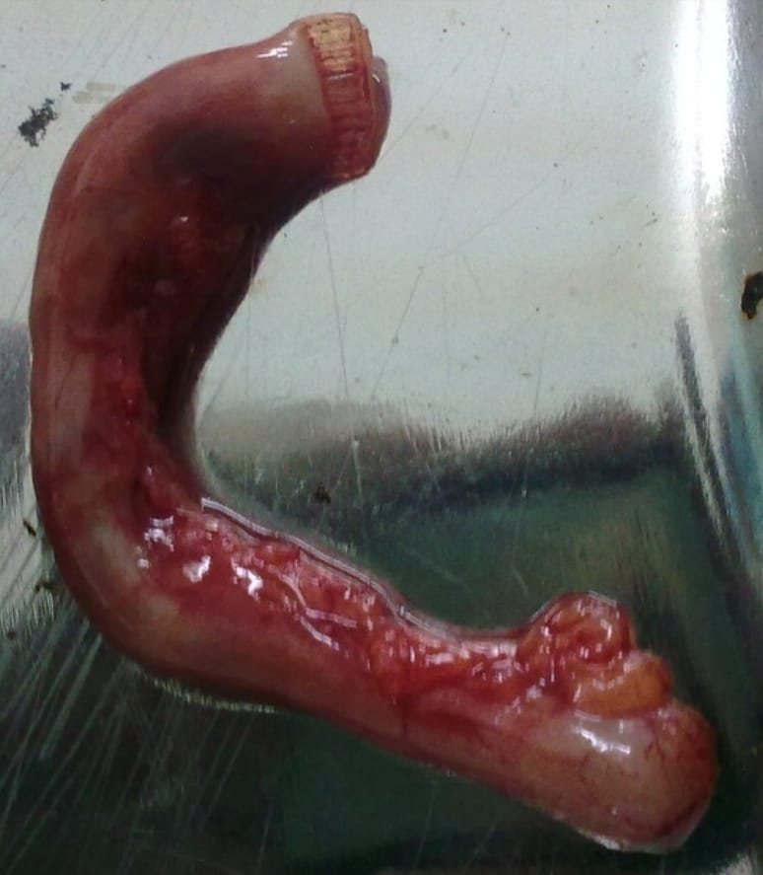
CASE DISCUSSION
WHAT IS ACUTE APPENDICITIS
It is the acute inflammation of the appendix caused by obstruction of the appendiceal lumen with resultant build up of fluid,secondary infection ,venous congestion, ischemia and necrosis.
Notes:
now coming towards the appendicitis……………..it is the……………………

Slide 30
CASE DISCUSSION
HOW DOES THIS INFLAMMATION OCCURS
Obstruction occurs due to
Faecolith
Foreign body
Fibrinous stricture from previous inflammation
Enlarged lymphoid follicles
Notes:
Obs occurs due to …………………..It is a stony mass of compacted faeces most common in decending and sigmoid colon small bowel or appendix

Slide 31
CASE DISCUSSION
HOW COMMON IT IS
Most common between the ages of 10 and 20 years but can occur at any age
Appendicitis is more common in men

Slide 32
CASE DISCUSSION
CLINICAL PRESENTATION
SYMPTOMS AND SIGNS
Pain in right iliac fossa associated with fever ,nausea ,vomiting or constipation
Tenderness, rebound tenderness, guarding and rigidity
Rovsings sign
Obturator sign
Psoas sign
Dunphys sign
Notes:
PT presents with pain in rif which may be associated with fever nausea vomiting or constipation.on abd examination tendernesss and rwebound tenderness are present with guarding and rigidity of abdomen,the clinician will perform the rovsing obt and psoas sign to elicit acute appendicitis

Slide 33
CASE DISCUSSION
HOW IT IS DIAGNOSED
Clinical Evaluation
Biochemical Investigations
Radiological Investigations
Notes:
Acute appendicitis is usually diagnosed with the help of clinical evaluation biochemical and radiological investigations

Slide 34
CASE DISCUSSION
POSSIBLE DIFFERENTIAL DIAGNOSIS
CHILDREN MALES FEMALES ELDERLY
Mesenteric adenitis Acute appendicitis Acute appendicitis Acute appendicitis
Acute appendicitis Ureteric colic Ovarian torsion CA colon
Gastroenteritis Torsion of testis PID Intestinal obstruction
Notes:
The possible differentials in different age groups are as flashed

Slide 35
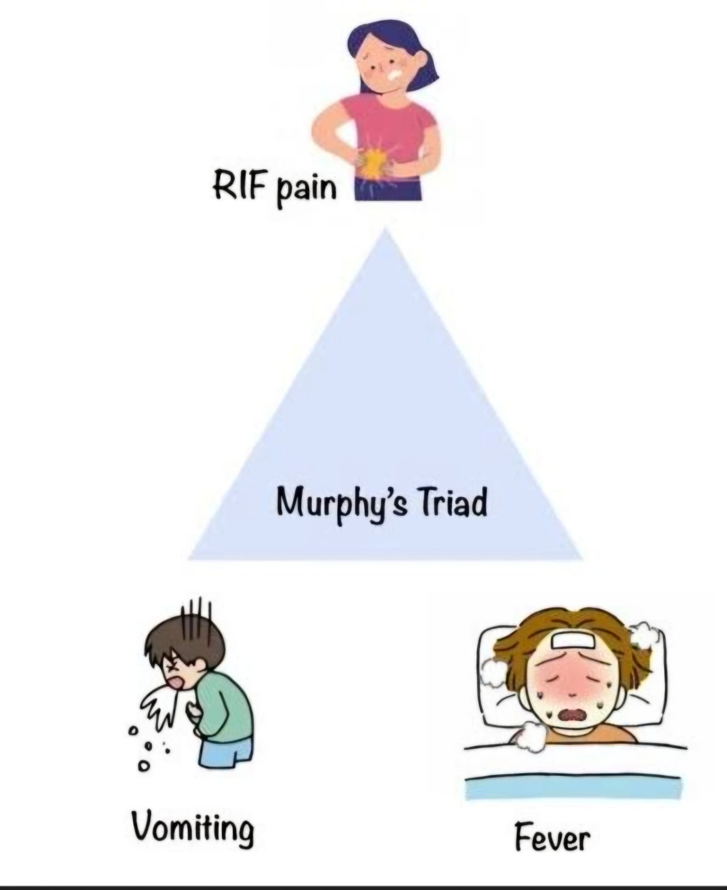
CASE DISCUSSION
CLINICAL DIAGNOSIS
MURPHYS TRIAD
Abdominal Pain
Fever
Nausea/vomiting
Notes:
The clinical diagnosis made upon the basis of signs and symptoms are abd pain fever and nausea

Slide 36
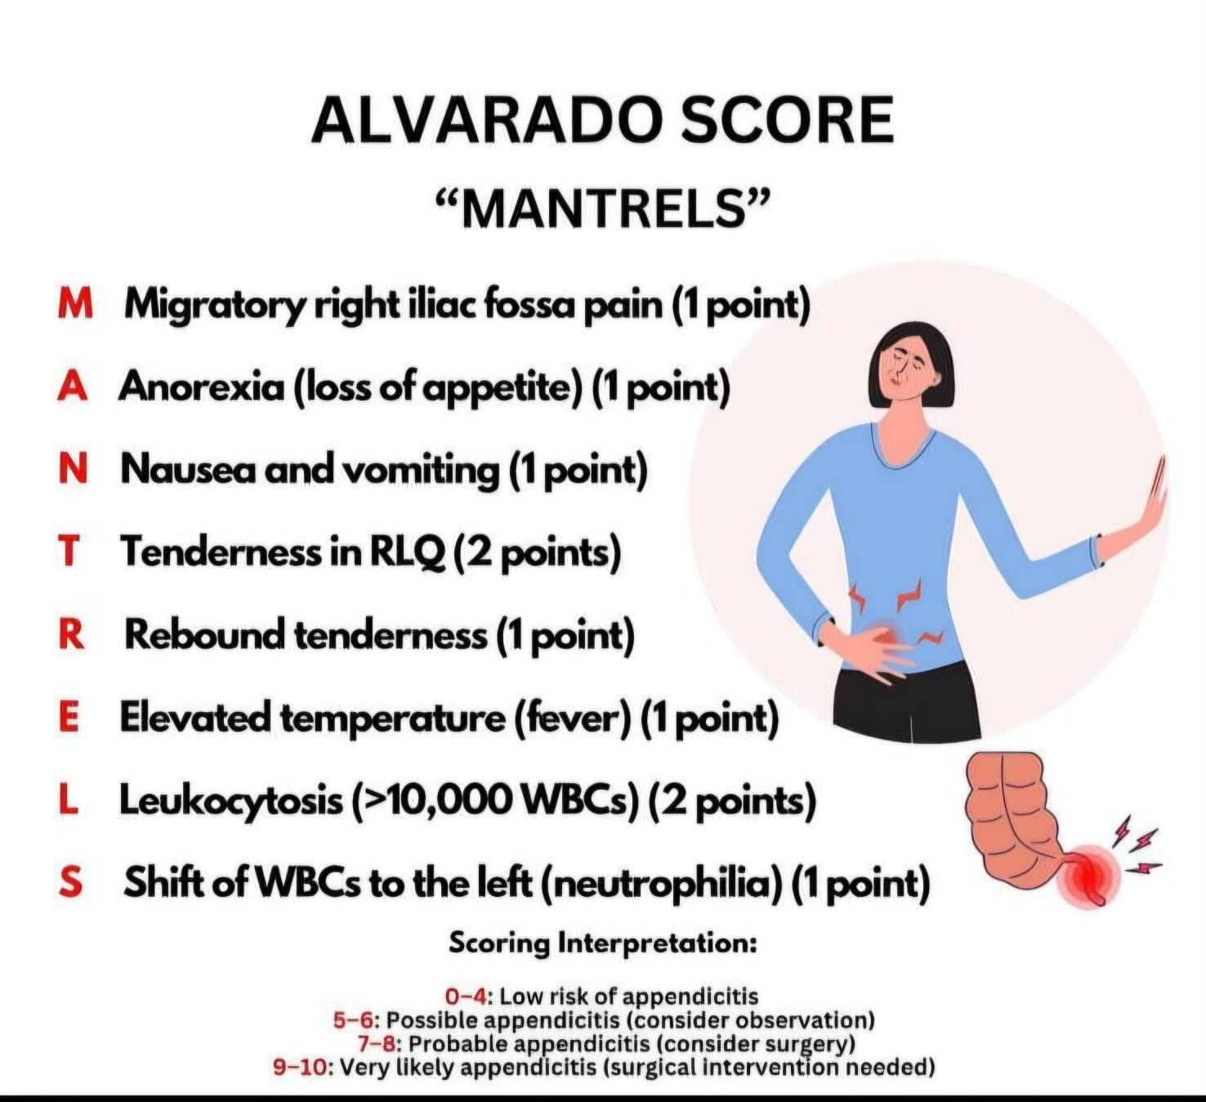
CASE DISCUSSION
CLINICAL DIAGNOSIS
MURPHYS TRIAD
Abdominal Pain
Fever
Nausea/vomiting
Notes:
Alvarodo scoring is imp in clinical diagnosis which states that if score ,,,,,,,

Slide 37
CASE DISCUSSION
BIOCHEMICAL INVESTIGATIONS
CBC
CRP
Urine complete examination
Notes:
The biochemical investigations include cbc crp and urine complete

Slide 38
CASE DISCUSSION
RADIOLOGICAL INVESTIGATION
X ray Abdomen
Fluoroscopy
USG abdomen & pelvis
CT abdomen and pelvis
CECT abdomen & pelvis
Notes:
The possible radiological investigations which can be done are ,…….

Slide 39
CASE DISCUSSION
PLAIN RADIOGRAPHY
Non specific
Appendicolith in 5 to 10 % of patients
Dilated caecum
Right lower quadrant mass indenting on caecum
Notes:
It is non specific it may show calcified appendicolith dilated caecum and right lower quadrant mass indenting on the caecum…it can also show free gas under diaphragm in case of perforation .gas locules in an abcess formation

Slide 40
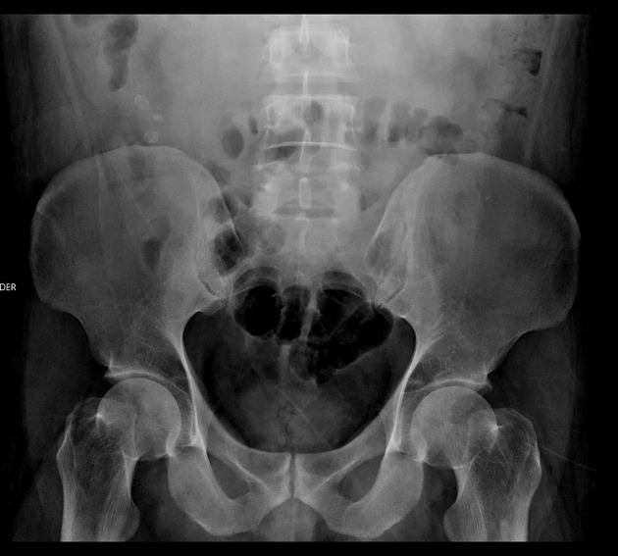
CASE DISCUSSION
XRAY ABDOMEN
Notes:
The shown image is an x ray abdomen erect demonstrating the presence of appendicolith projecting over the right iliac crest.

Slide 41
CASE DISCUSSION
FLUOROSCOPY
Non filling of appendix
Focal mural thickening of medial wall of caecum
Notes:
On barium enema non filling of the appendix is seen with focal mural thickening of the medial wall of the cecum

Slide 42
CASE DISCUSSION
ULTRASOUND
Sensitivity of 85% and specificity of 92 %
Non compressible,
Blind ended tubular structure
Maximum appendiceal diameter greater than 6 mm
Shadowing appendicolith
Target sign
Mc Burneys sign
Notes:
Now coming towards the second modality Its sentivity is 85 % and specificity is 92% in thin lean pts and paediatric age group ….on ultrasound the primary signs of inflamed appendix are a non compressible aperistaltic blind tubular structure in right iliac fossa, which may show appendicolith in its lumen having a caliber greater than 6 mm and wall thickness greater than 3 mm.it also demonstrates target sign and mc burneys sign

Slide 43
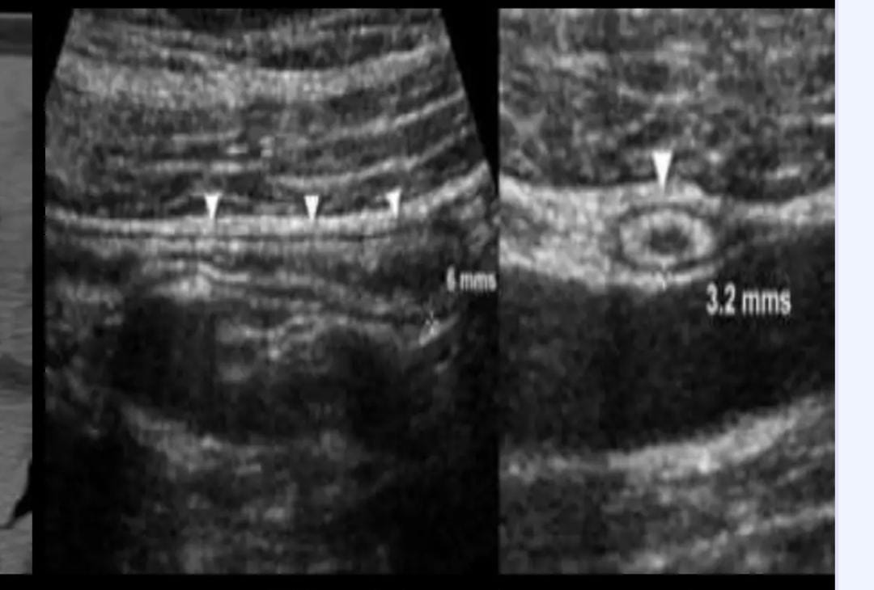
CASE DISCUSSION
USG ABDOMEN AND PELVIS
Notes:
Now ill show u the normal appendix ….Normal appendix is compressible, with a diamtere less than 6mm,wall thickness of less than 3 mm with no evidence of hypervascularisation

Slide 44
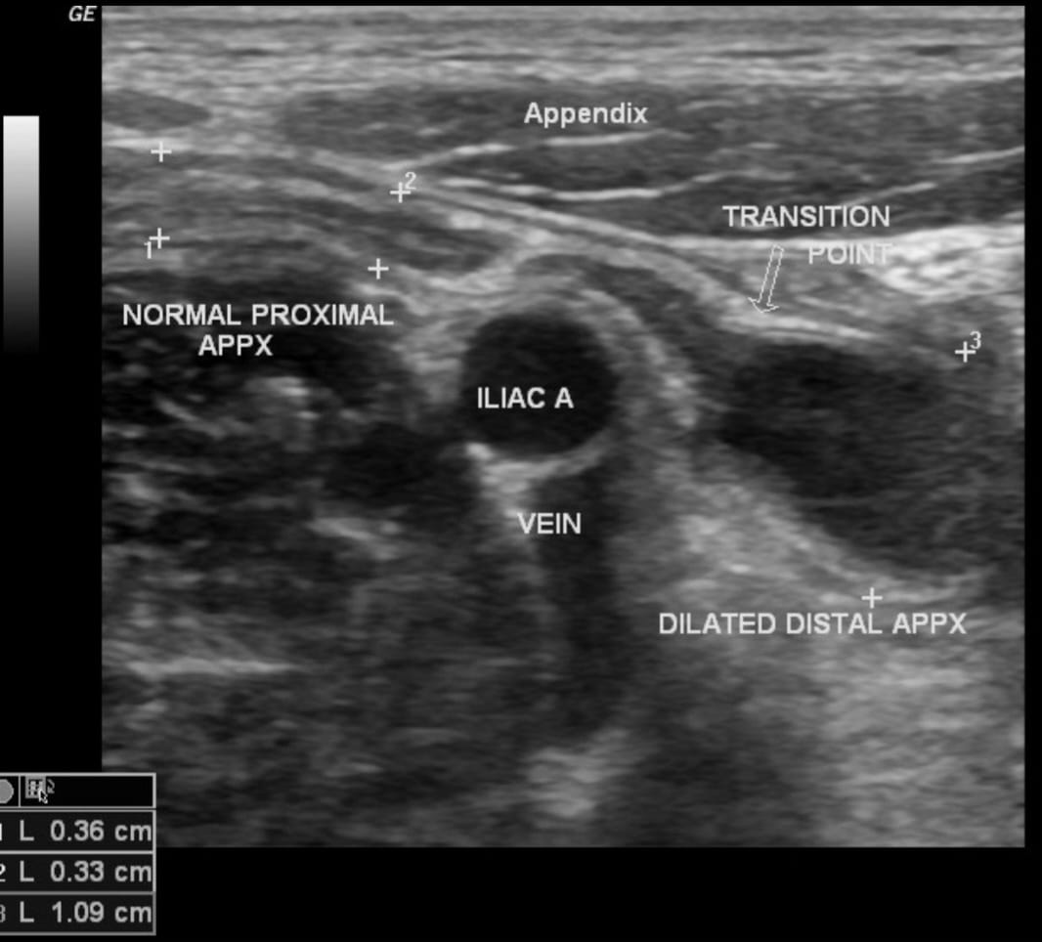
CASE DISCUSSION
USG ABDOMEN AND PELVIS
Notes:
This grey scale usg image of acute appendix showing diameter more than 6 mm.

Slide 45
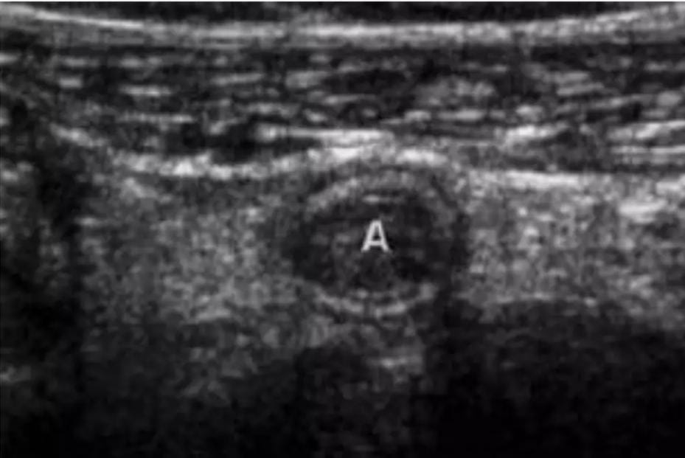
CASE DISCUSSION
USG ABDOMEN AND PELVIS
Notes:
This grey scale usg image of acute appendix showing target sign. With hypoechoic center indicating fluid filled lumen,hperechoic rim indicateing mucosal\ submucosal layer, and hypoechoic ring indicating muscular layer

Slide 46
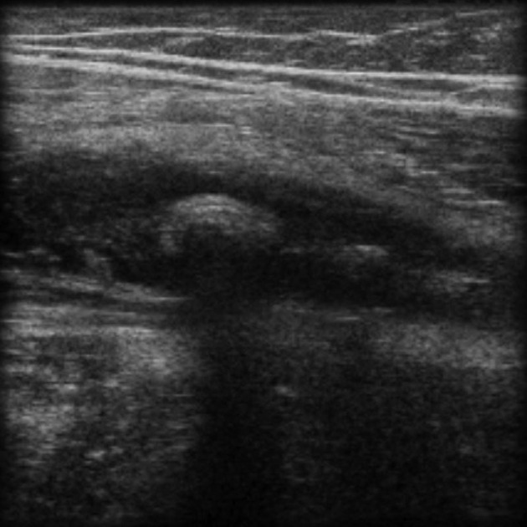
CASE DISCUSSION
USG ABDOMEN AND PELVIS
Notes:
.

Slide 47
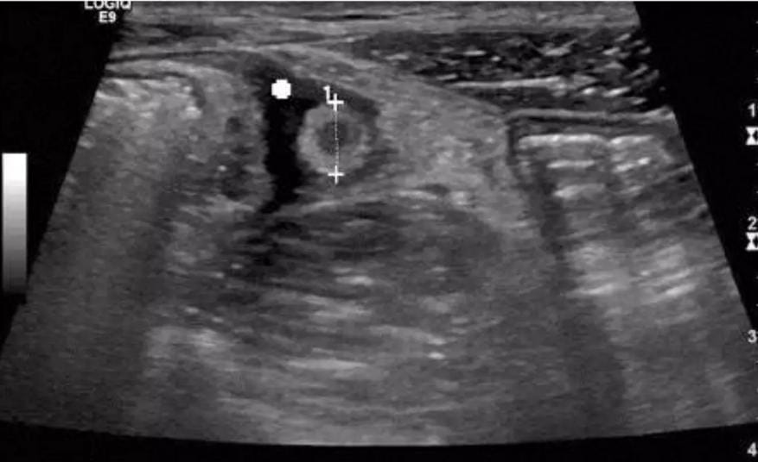
CASE DISCUSSION
USG ABDOMEN AND PELVIS
Notes:
Secondary features of acute appendicitis on USG are free fluid surrounding appendix,local abcess formation,increased echigenicity of local mesenteric fat.
The usg image shows increased diameter of appendix with surrounding free fluid.

Slide 48
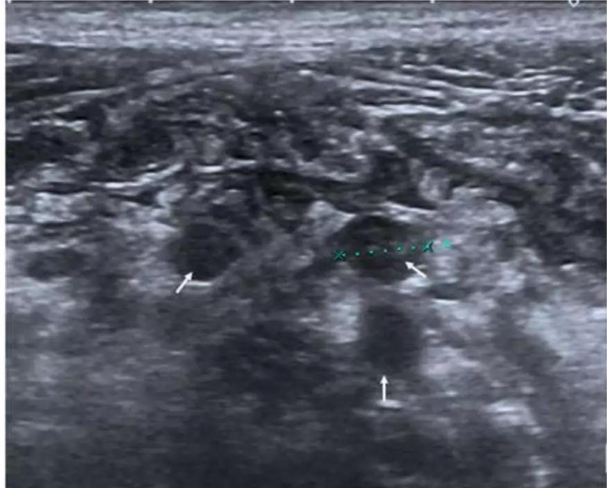
CASE DISCUSSION
USG ABDOMEN AND PELVIS
Notes:
The usg image shows multiple lymph nodes in mesentery of periappendiceal region.

Slide 49
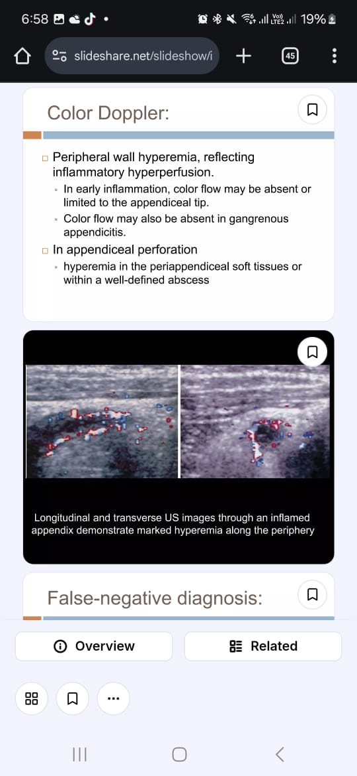
CASE DISCUSSION
COLOUR DOPPLER
Peripheral wall hyperemia reflecting inflammatory hyperperfusion
Hyperemia in periappendiceal soft tissue or within a well defined abscess in case of appendiceal perforation
Notes:
Colour Doppler shows increased colour flow in the peripheral wall which reflects inflammatory hyperperfusion in acute appendici

Slide 50
CASE DISCUSSION
CT SCAN
CT is highly sensitive 98% and specific 97% for the diagnosis of acute appendicitis
Appendicolith
Extraluminal fluid
Caecal bar sign
Arrowhead sign
Inflammatory phlegmon
Abscess formation
Notes:
Now coming towards the most sensitive modality CT scan is highly sensitive and specific for the diagnosis of acute appendicitis which may show a dilated appendix with appendicolith in its lumen, peri appendiceal fat stranding and extraluminal fluid.We can also appreciate caecal bar sign and arrow head sign in CECT. Phlegmon and abcess formation on CT indicates complicated appendicitis

Slide 51
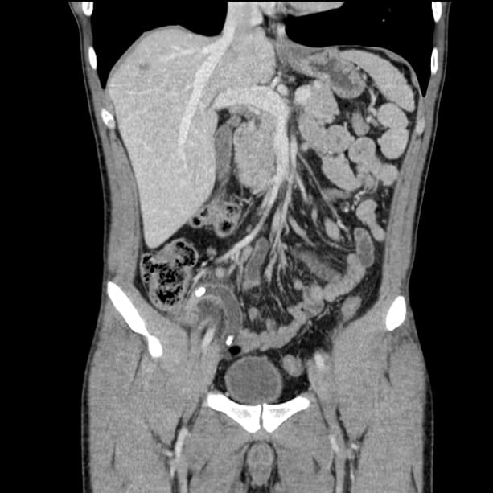
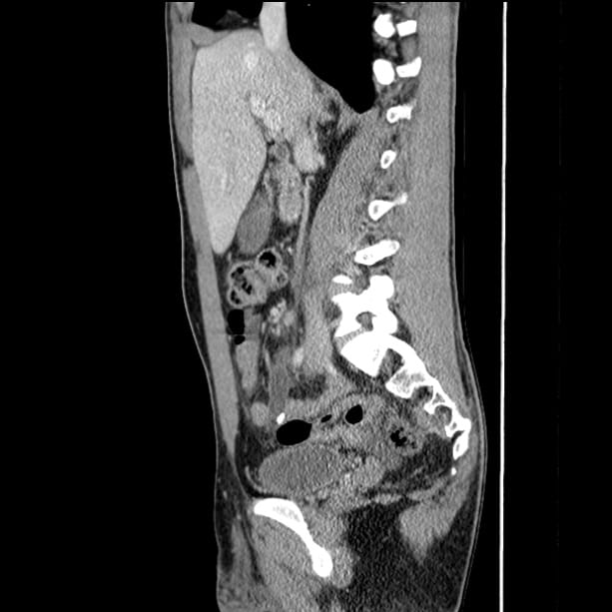
CASE DISCUSSION
CECT ABDOMEN & PELVIS
Notes:
These are coronal and sagittal sections of CECT abdomen and pelvis showing dilated appendix with appendicolith in its lumen.

Slide 52
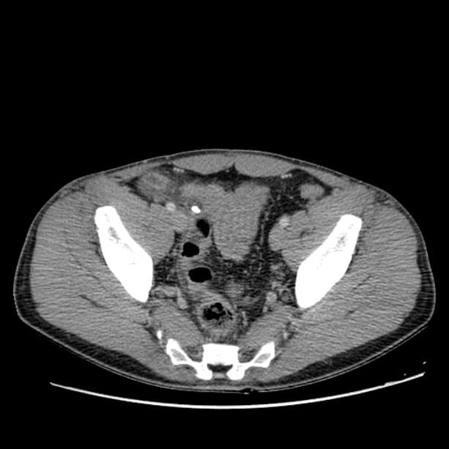
CASE DISCUSSION
CECT ABDOMEN & PELVIS
Notes:
This is the axial section of CECT abd and pelvis showing appendicolith in its lumen.

Slide 53
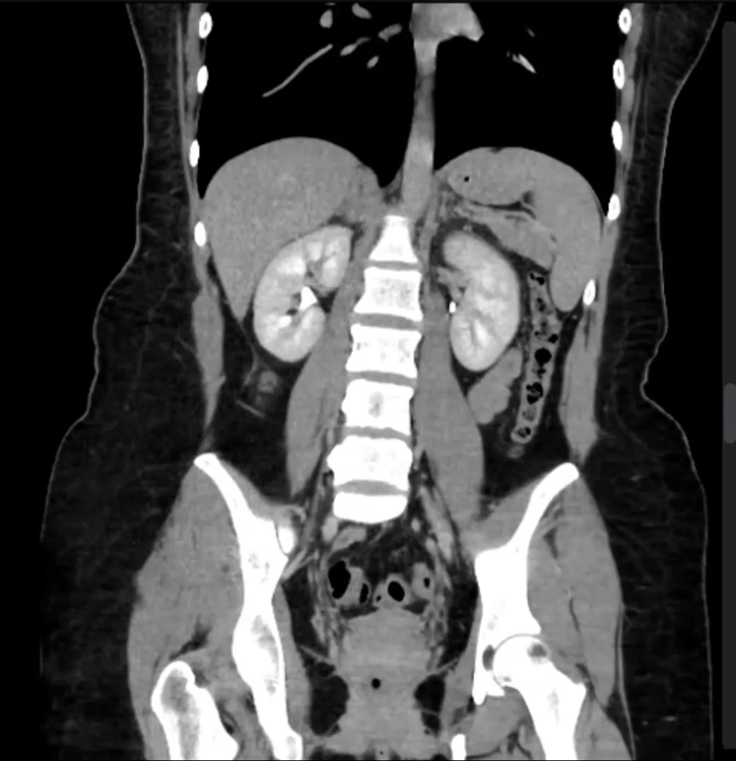
CASE DISCUSSION
CECT ABDOMEN & PELVIS(VIDEO)
Notes:
This is the axial section of CECT abd and pelvis showing appendicolith in its lumen.

Slide 54
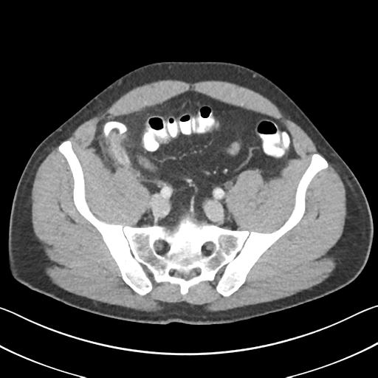
CASE DISCUSSION
CECT ABDOMEN & PELVIS
The ceacal bar sign
Appearance of inflammatory soft tissue at the base of the appendix, separating the appendix from the contrast-filled caecum.
Notes:
This is the axial section of CECT abd and pelvis showing ceacal bar sign.
. There is soft tissue thickening at the base of the appendix consistent WITH CECAL BAR SIGN

Slide 55
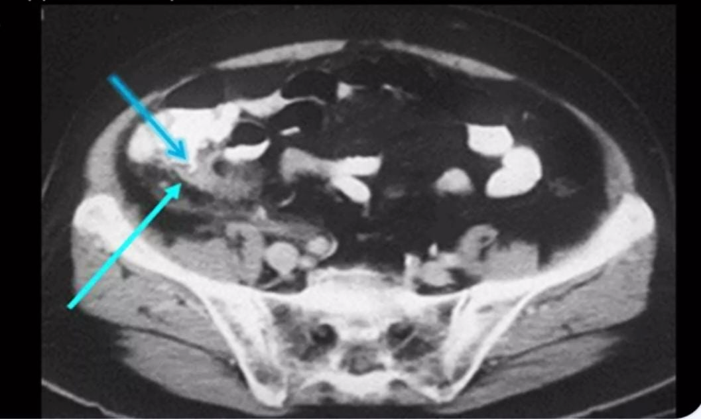
CASE DISCUSSION
CECT ABDOMEN & PELVIS
The arrowhead sign
refers to the focal caecal thickening centred on the appendiceal orifice, seen as a secondary sign in acute appendicitis.
Notes:
ThE CONTRAST MATERIAL IN CECAL LUMEN ASSUME AN ARROW HEAD CONFIGURATION POINTING AT THE APPENDIX

Slide 56
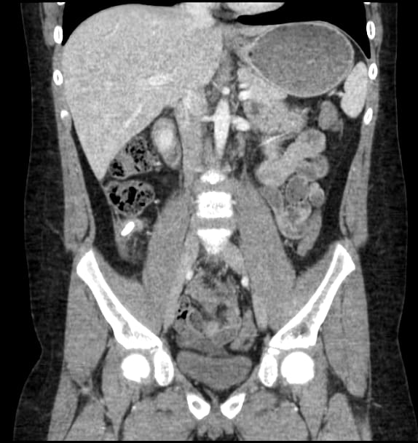
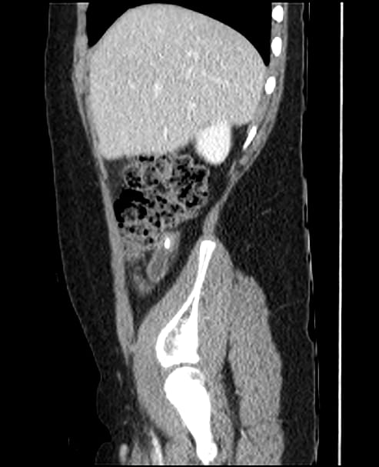
CASE DISCUSSION
RETROCAECAL APPENDIX
Notes:
This is the coronal and mid saggital of CECT abd and pelvis showing retrocaecal appendix appendicolith in its lumen.

Slide 57
CASE DISCUSSION
COMPLICATIONS OF APPENDICITIS
Abscess Formation
Gangrenous Appendicitis
Perforation
Notes:
Now coming towards the complication of acute appendicitis ….it may result in abscess formation ,gangrene formation and perforation.

Slide 58
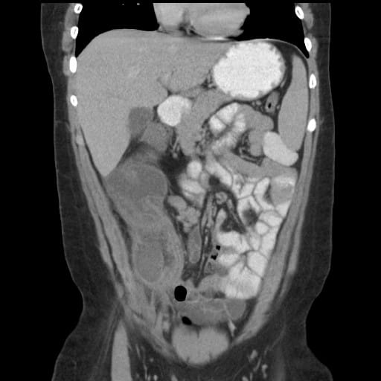
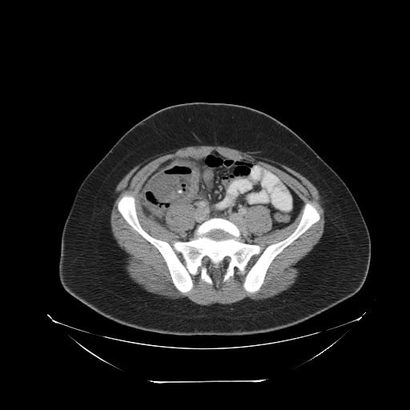
CASE DISCUSSION
ACUTE APPENDICITIS WITH ABCESS FORMATION
Notes:
This is the axial section of CECT abd and pelvis showing acute appendicitis with abscess formation.
Large fluid collection located in the right lower quadrant with air-fluid levels, extending to the subhepatic space surrounded by thick irregular enhancing wall and surrounding fat stranding. No phlegmon.Dilated fluid-filled appendix with a small calcified appendicolith at the base of the collection.

Slide 59
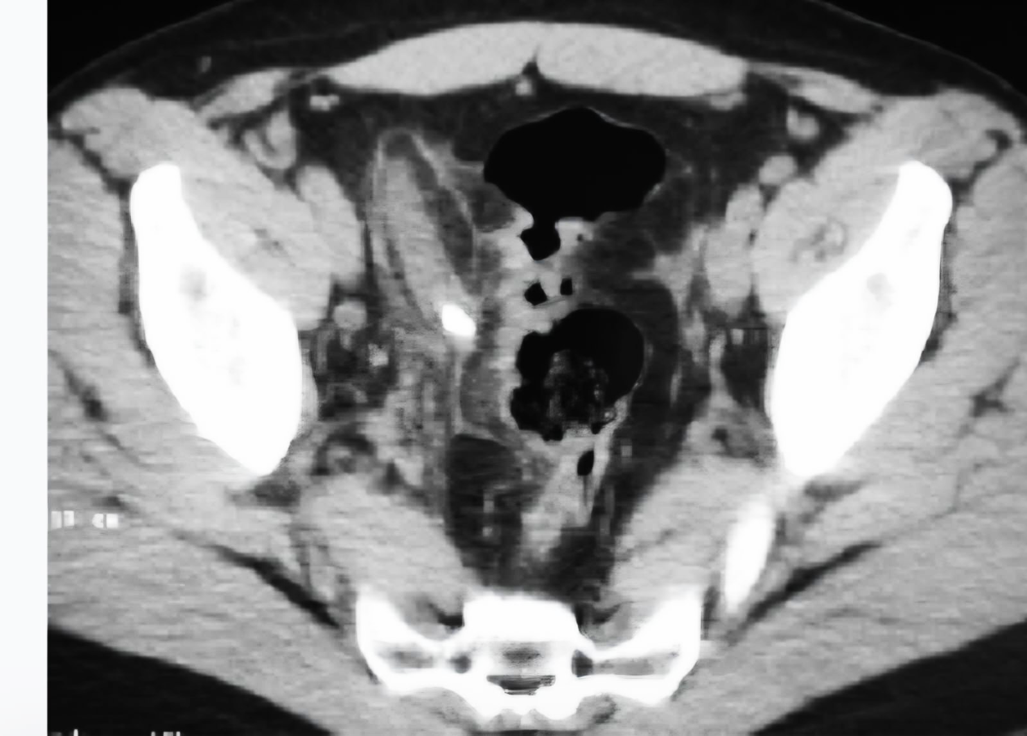
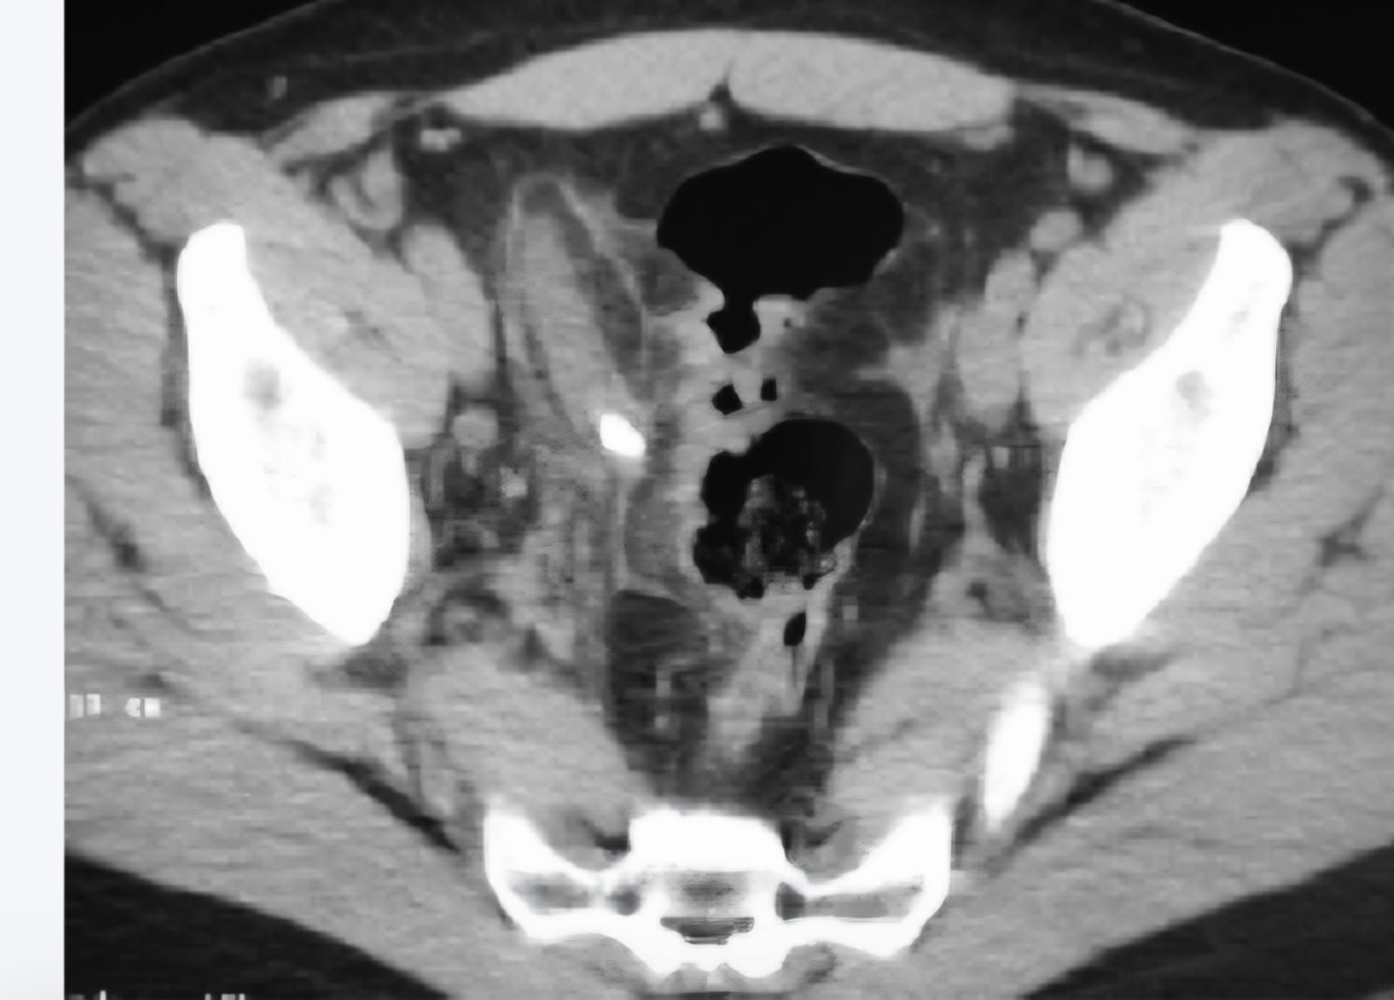
CASE DISCUSSION
GANGRENOUS APPENDIX
Notes:
This is theaxial section of CECT abd and pelvis showing Gangrenous appendix
Dilated pelvic appendix with a maximum diameter of 12 mm containing a large appendicolith with thinning of the wall suggestive of gangrenous appendix

Slide 60
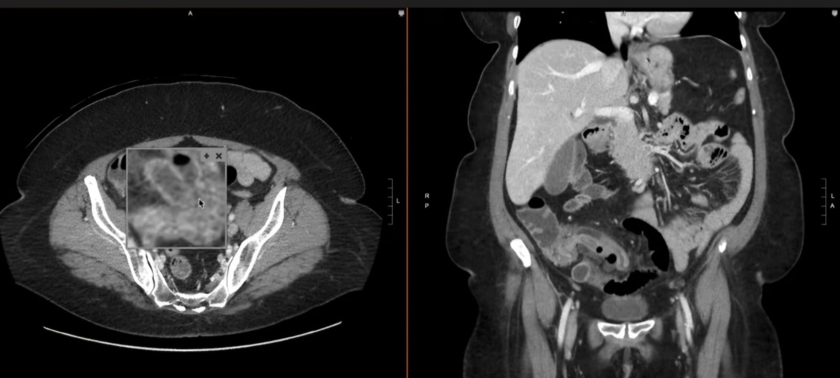
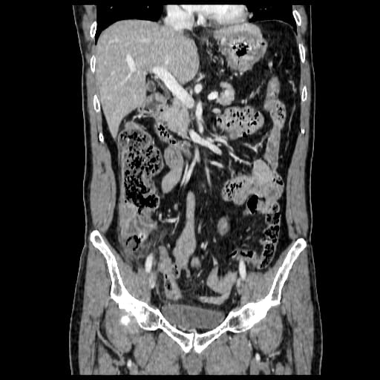
CASE DISCUSSION
PERFORATED APPENDIX
Notes:
This is the coronal section of CECT abd and pelvis showing perforated appendix.
The appendix, located in the right iliac fossa, is enlarged (diameter ~15 mm), with intraluminal fluid, gas. There is periappendiceal fat stranding, discontinuity of the appendiceal wall at its base, associated with extraluminal gas in the surrounding region.

Slide 61
CASE DISCUSSION
DIFFERENTIAL DIAGNOSIS
Mesenteric adenitis
Caecal diverticulitis
Crohns disesase
Appendiceal mucocele
Notes:
The radiological differentials may include

Slide 62
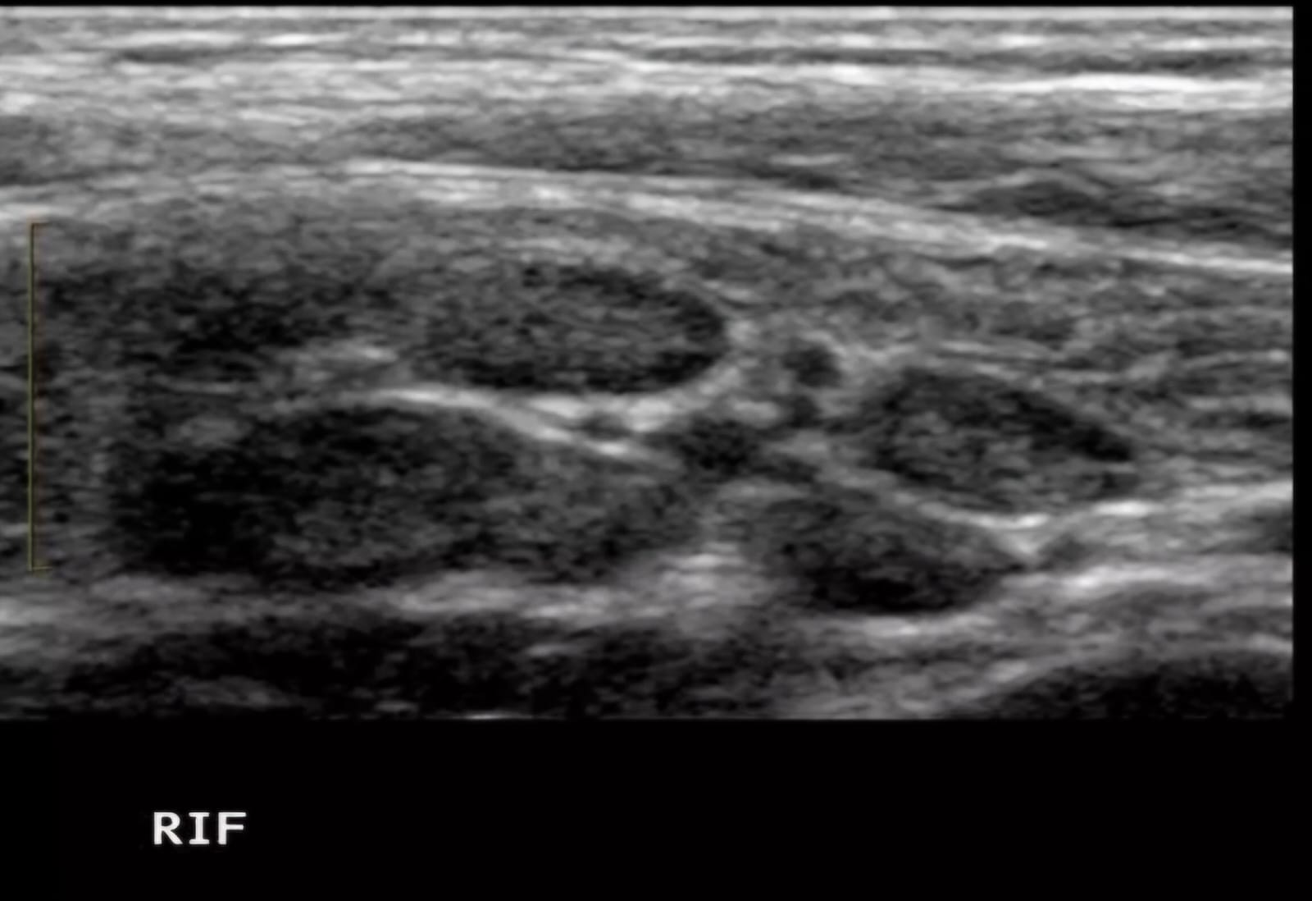
CASE DISCUSSION
DIFFERENTIAL DIAGNOSIS
Mesenteric adenitis
Notes:
It is the inflammation of the ileocolic lymph nodes greater than 5mm in paediatrics

Slide 63
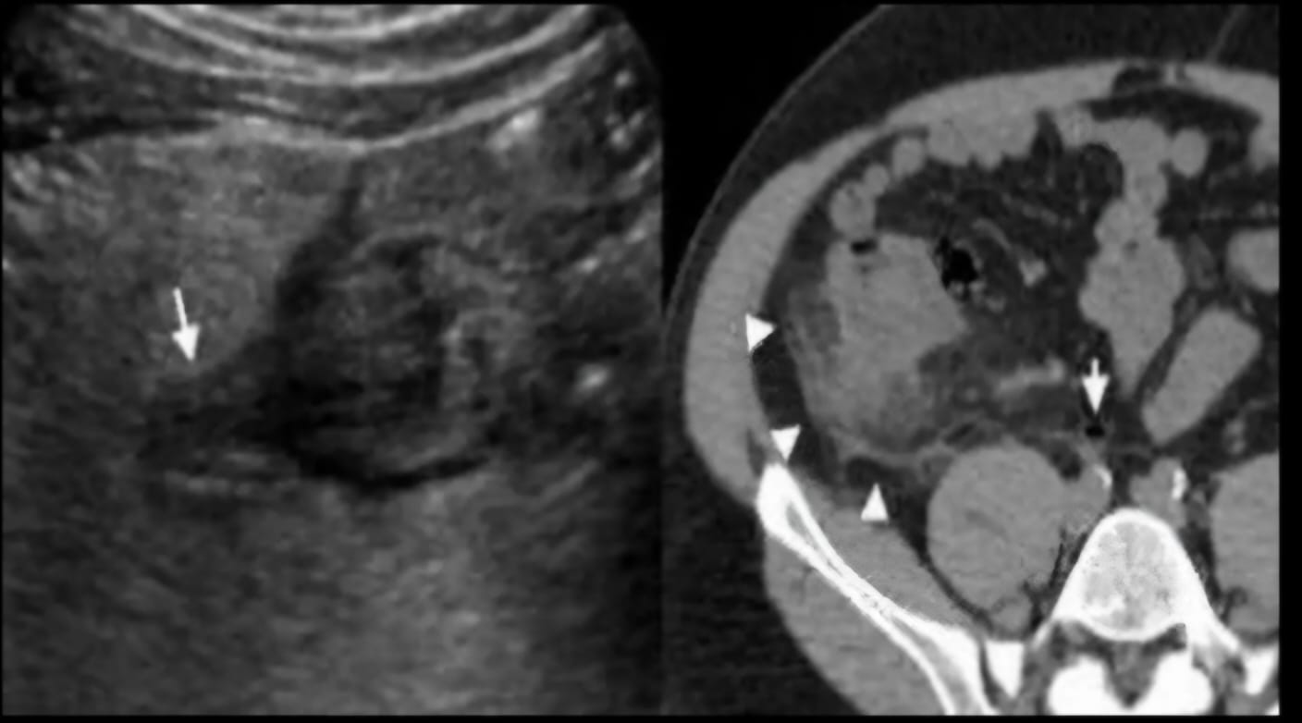
CASE DISCUSSION
DIFFERENTIAL DIAGNOSIS
Caecal diverticulitis
Notes:
Ct shows fat stranding along cecal wall and a normal appendix
Usg shows inflamed cecal diverticulum centred in hyperechoic fat

Slide 64
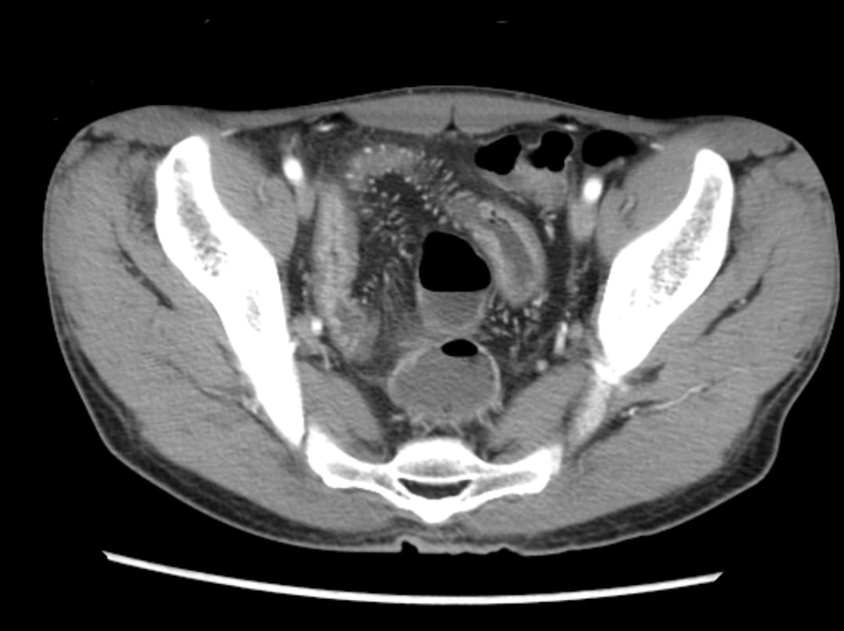
CASE DISCUSSION
DIFFERENTIAL DIAGNOSIS
Crohns disease
Notes:
Crohns disease is basically a chronic granulomatous inflammatory condition that can involve any segment of git but most commonly terminal ileum and right colon ……..ct shows prominent perienteric vasculature giving comb sign appearance

Slide 65
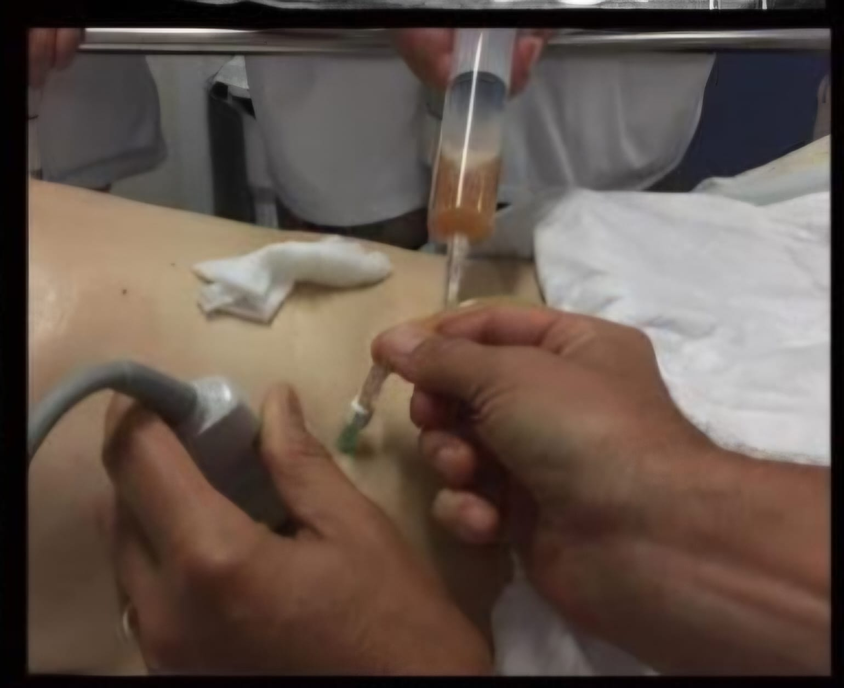
LITERATURE REVIEW
TREATMENT AND PROGNOSIS
APPENDECTOMY
Open(laparotomy)
Laproscopically
Mortality from simple appendicitis is 0.1 %
Mortality 5 % in case or perforation
USG /CT GUIDED PERCUTANEOUS
ABSCESS DRAINAGE
Notes:
So radiologists play a therapeutic role in percutaneous abcess drainage

Slide 66
LITERATURE REVIEW
INCIDENCE
GLOBAL INCIDENCE:
Lifetime incidence of acute appendicitis is 8.6 % in males and 6.7% in females.
PAKISTAN INCIDENCE:
110000 cases were reported during the previous year in Pakistan indicating a high disease burden
Notes:
Acc ording to clinical practice article………….general of pak medical association

Slide 67
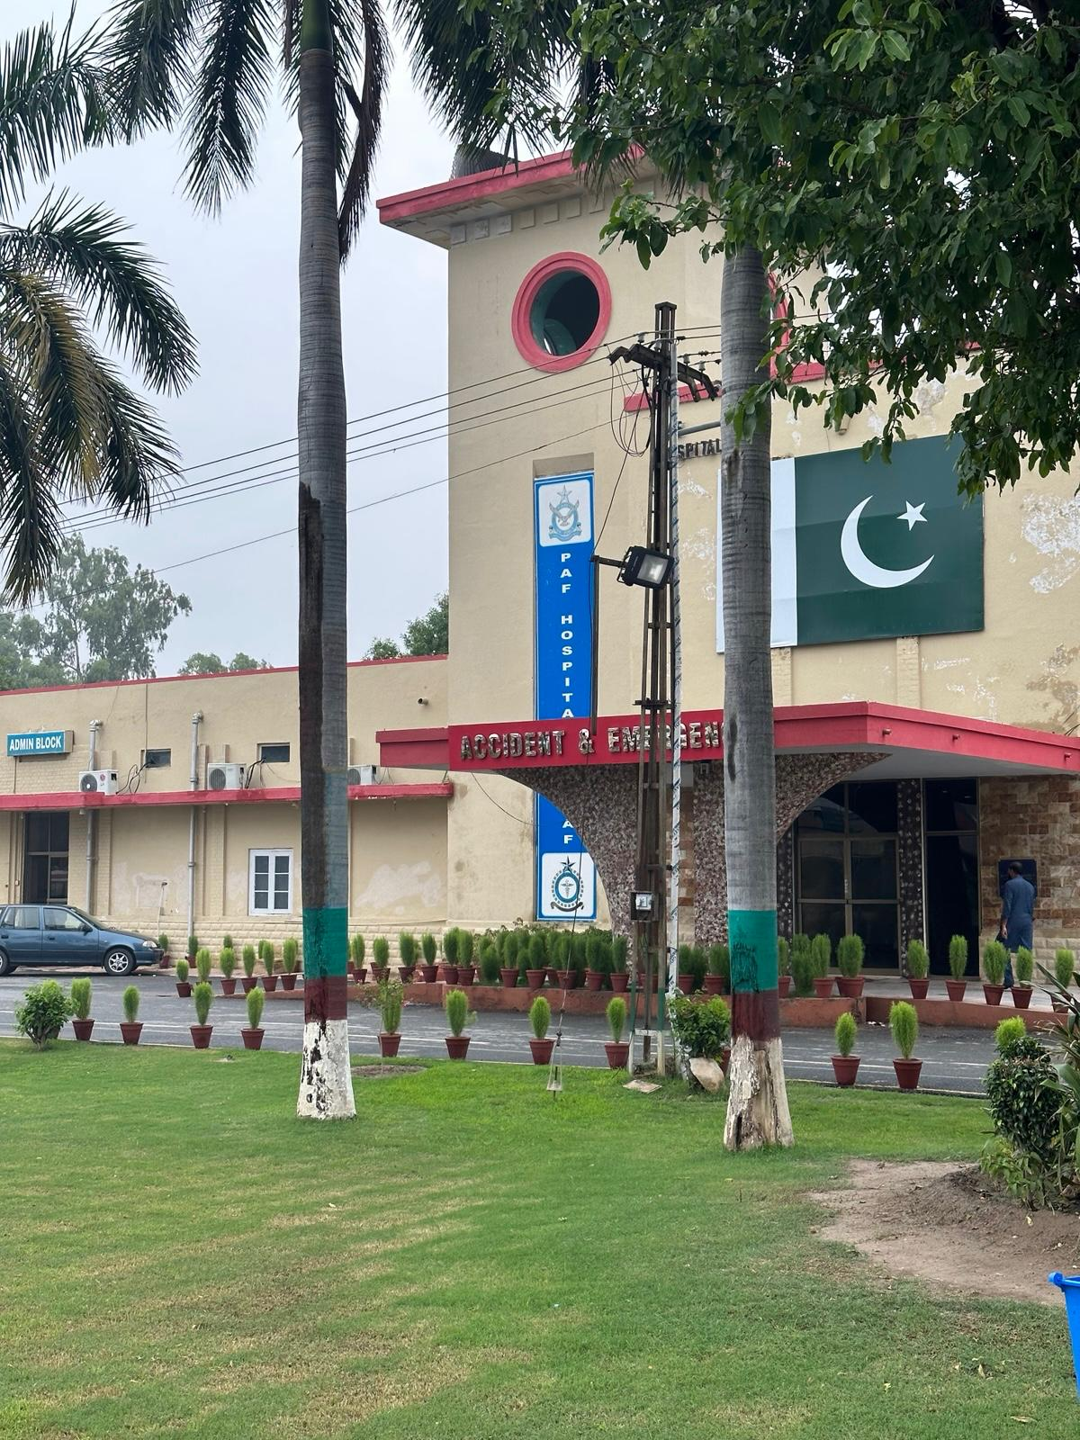
LITERATURE REVIEW
INCIDENCE
Acute appendicitis Cases reported in PAF Hospital Mushaf:
Total Cases : 21
Year 2025
Notes:
In PAF Hospital Mushaf , total 21 cases have been reported in previous year

Slide 68

CONCLUSION
Timely and accurate diagnosis of acute appendicitis is critical to prevent complications such as perforation and sepsis
Radiology particularly ultrasound and CT scan plays a pivotal role in confirming diagnosis
Imaging significantly reduces negative appendectomy rates
Notes:
To prevent complications such as perforation and sepsis
Imaging significantly reduces negative appendectomies ensuring targeted and effective patient management

Slide 69
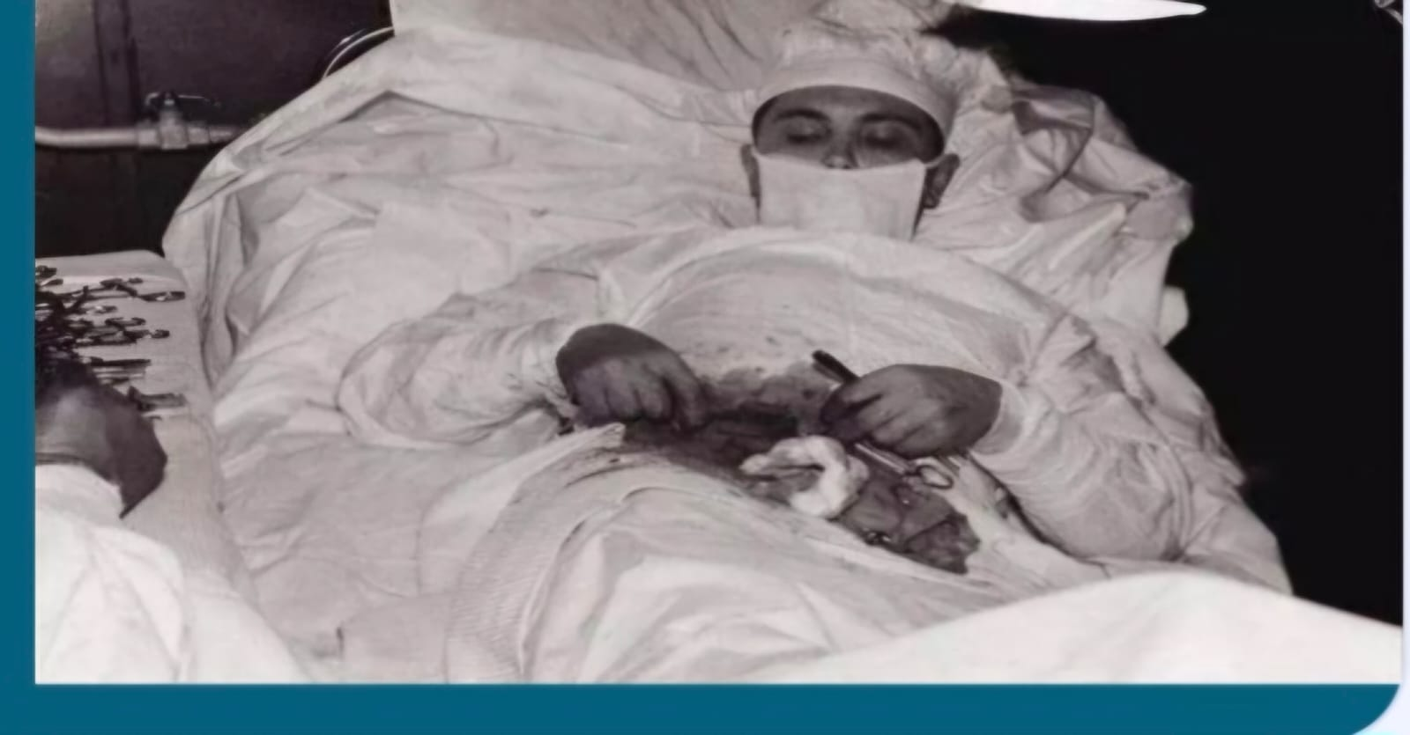
CASE DISCUSSION
INTERESTING FACT
SELF APPENDECTOMY
Dr Leonid On 30 April 1961 was only physician on the station
So he underwent self appendectomy using a mirror which took 2 hrs.

Slide 70
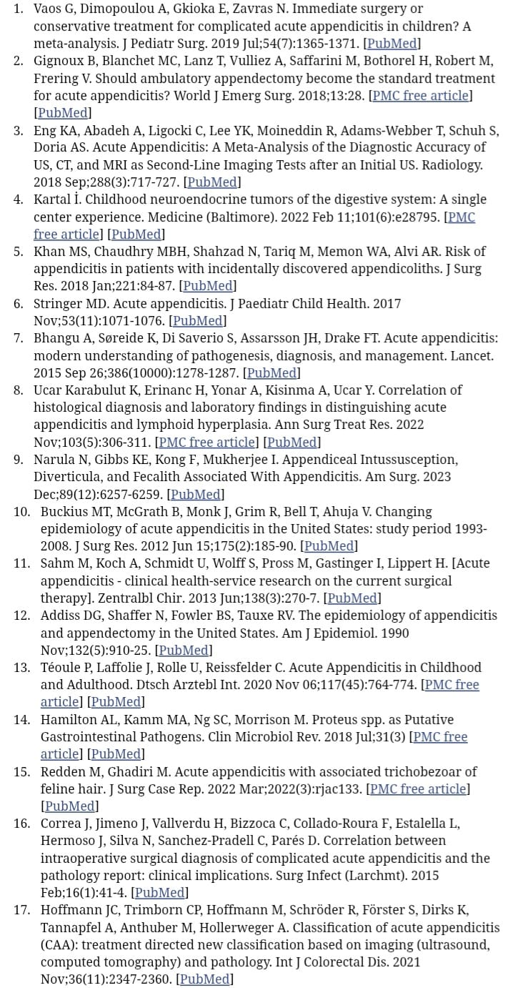
CASE DISCUSSION
REFERENCES
Notes:
These are the references of my presentation

Slide 71


Slide 72

Notes:
Any questions please

